Slide 1
CAA Group Work

Slide 2
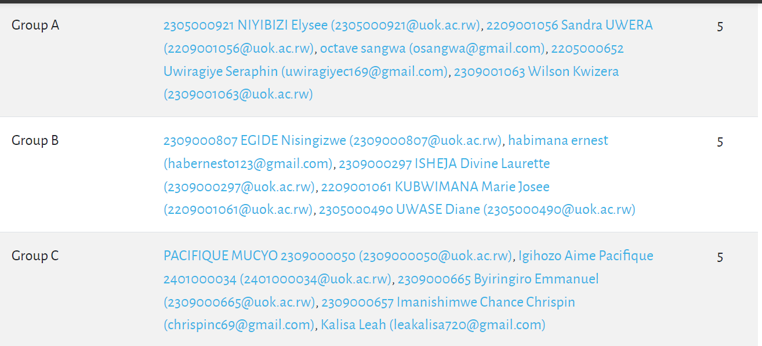

Slide 3


Slide 4


Slide 5
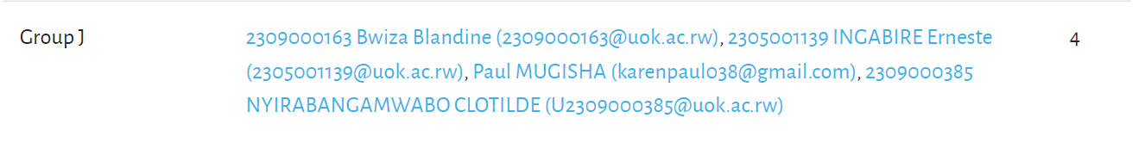

Slide 6
Group A
What are the fundamental concepts that define the language of the computer in terms of instructions and how they are processed by the hardware? Discuss the importance of these concepts in understanding computer architecture.
Explain the concept of Instruction Set Architecture (ISA) and its role in defining the machine language of a computer. How does the ISA impact the design and functionality of a computer system? Provide examples of different ISAs and their implications.
Explore the various instruction formats and types that exist in computer architecture. How do these formats influence the execution of instructions by the processor? Discuss the trade-offs involved in choosing different instruction formats.
Break down the instruction execution cycle, highlighting the different stages involved, such as fetch, decode, execute, and write back. What role does each stage play in the overall process of executing instructions? How does a computer's architecture optimize these stages for efficiency?
Discuss the relationship between computer architecture and compilers. How does the design of a computer's instruction set impact the work of a compiler? Consider the challenges and opportunities that arise when translating high-level programming languages into machine code for diverse architectures.

Slide 7
Group B
In the context of the Von Neumann Architecture, how has the evolution of computing architectures shaped the design of modern computers? Discuss any advancements or modifications to the basic components and their implications on performance and efficiency.
Von Neumann Architecture is inherently sequential in its execution of instructions. Explore the challenges and benefits associated with introducing parallel processing in the context of CPU, Memory, and Input/Output components. How can parallelism be effectively integrated into a design rooted in Von Neumann principles?
Discuss the trade-offs between memory access speed and capacity within the Von Neumann Architecture. How do designers balance the need for faster access times with the increasing demand for larger memory capacities? Consider technological advancements and their impact on this trade-off.
Investigate the role of cache memory in the Von Neumann Architecture. How does cache memory contribute to improving the overall performance of a computer system, especially in terms of the Fetch-Decode-Execute cycle? Discuss the challenges and strategies associated with cache management.
With advancements in data-intensive applications and emerging technologies, how might the role of Input/Output systems evolve within the Von Neumann Architecture? Discuss potential challenges and innovations in designing I/O systems to meet the demands of future computing applications.

Slide 8
Group C
Explore the role of the Control Unit in the execution of instructions. How does the Control Unit coordinate and synchronize different components of the CPU during instruction execution? Discuss the significance of a well-designed Control Unit in achieving efficient and reliable processing.
Delve into the functions of the Arithmetic Logic Unit (ALU) within the CPU. How does the ALU contribute to mathematical computations and logical operations? Discuss real-world examples where the ALU's capabilities play a crucial role in the overall performance of a computer system.
Examine the analogy of the processor being the "heart" of the computer. In what ways is the processor central to the functioning of a computer system? Discuss how advancements in processor technology impact overall system performance, power efficiency, and the ability to handle diverse computing tasks.
Provide an overview of CPU registers, including key registers such as the Program Counter (PC) and Instruction Register (IR). How do these registers contribute to the execution of programs? Discuss the advantages and challenges of different register configurations in a CPU.
Investigate the role of control signals in coordinating operations within the CPU. How do control signals facilitate communication between different components like the ALU, registers, and memory? Discuss the importance of well-defined control signals in achieving precise and predictable operation.

Slide 9
Group D
Discuss the role of memory interfaces in connecting various types of memory (RAM, ROM, cache) to the CPU. How does the design of memory interfaces impact the speed and efficiency of data transfer between the CPU and different types of memory? Consider the importance of memory hierarchy in optimizing system performance.
Explore the functions of different buses – Address Bus, Data Bus, and Control Bus – in the context of data transfer within a computer system. How do these buses work together to facilitate the movement of information between the CPU, memory, and peripheral devices? Discuss the significance of bus width and speed in determining data transfer rates.
Investigate the role of device controllers in facilitating communication between peripheral devices and the CPU. How do device controllers manage data transfer, and what strategies are employed to optimize the interaction between devices and the central processing unit?
Compare and contrast prominent bus standards such as PCI, USB, and SATA. How do these standards differ in terms of data transfer speed, versatility, and application domains? Discuss the impact of these standards on the evolution of computer architecture and connectivity.
Examine the advantages and disadvantages of serial and parallel interfaces. How do these two approaches differ in terms of data transfer speed, complexity, and susceptibility to interference? Discuss real-world applications where one type of interface might be more suitable than the other.
Explore the various communication protocols employed in different interfaces. How do protocols ensure reliable and efficient data transfer between components? Discuss the role of standardization in promoting interoperability and compatibility among diverse devices and systems.

Slide 10
Group E
Provide an overview of the key differences between RISC (Reduced Instruction Set Computing) and CISC (Complex Instruction Set Computing) architectures. How do these architectural approaches impact the design, execution, and performance of computer systems? Discuss real-world applications where each architecture excels.
Explore the role of special-purpose co-processors in enhancing the performance of computer systems. How do co-processors complement the main processor in specific tasks, such as graphics processing, cryptography, or signal processing? Discuss the advantages and challenges of integrating co-processors into a computing architecture.
Introduce the concept of multiprocessor systems and parallel processing. How do multiprocessor systems differ from single-processor systems in terms of architecture and performance? Discuss the motivation behind using multiple processors to execute tasks concurrently.
Discuss the benefits of parallel computing in the context of multiprocessor systems. How does parallel processing improve overall system performance, scalability, and efficiency? Consider specific applications where parallel computing is particularly advantageous.
Explore the challenges associated with implementing and managing parallel computing in multiprocessor systems. What are the synchronization and communication challenges that arise when multiple processors work in parallel? Discuss strategies to address these challenges and ensure effective parallelization.

Slide 11
Group F
What are the fundamental components of an instruction format, and how do they contribute to the execution of instructions? Discuss the importance of clarity and consistency in instruction formats for both human understanding and machine interpretation.
Compare and contrast fixed-length and variable-length instruction formats. How do these formats impact the efficiency of instruction execution and memory utilization? Discuss scenarios where one format might be more advantageous than the other.
Explore the various addressing modes commonly used in instruction formats. How do addressing modes affect the way operands are specified in instructions? Discuss the trade-offs between different addressing modes in terms of flexibility, complexity, and execution efficiency.
Examine the roles of opcodes and operands in instruction formats. How do opcodes represent operations, and what is the significance of operands in defining the data manipulated by instructions? Discuss the flexibility of instruction formats in accommodating various operations and data types.
Provide an introduction to microinstructions and their role in instruction execution. How do microinstructions contribute to the implementation of complex instructions at the microarchitectural level? Discuss the relationship between macroinstructions (visible to the programmer) and microinstructions (executed by the control unit).

Slide 12
Group G
Explore the different types of instructions, such as data transfer, arithmetic and logic, and control transfer instructions. How do these instruction types contribute to the execution of programs? Discuss real-world examples where each type plays a critical role in application development.
Provide an overview of instruction sets and the operations supported by the CPU. How does the design of an instruction set impact the capabilities and efficiency of a processor? Discuss the trade-offs in choosing the types and complexity of instructions in an instruction set architecture.
Examine the memory organization and hierarchy within a computer system, including registers, cache, RAM, and disk storage. How does the memory hierarchy contribute to the speed and efficiency of data access? Discuss the roles of each memory level in storing and retrieving information during program execution.
Explore various addressing schemes used in instruction sets, such as immediate, direct, register, and indirect addressing. How do these addressing schemes determine how operands are specified and accessed in instructions? Discuss the advantages and limitations of each addressing scheme in different programming scenarios.
Discuss the trade-offs involved in the design of instruction sets, considering factors like instruction complexity, addressing modes, and the balance between general-purpose and specialized instructions. How does the choice of instruction set design impact overall system performance and ease of programming?

Slide 13
Group H
Discuss the process of translating high-level language constructs, such as loops, conditionals, and functions, into equivalent assembly language code. What challenges and considerations arise during this translation process? How does the simplicity or complexity of the high-level language impact the corresponding assembly code?
Provide specific examples of how common high-level language constructs like loops, conditionals, and functions can be implemented in assembly language. Explore the differences in syntax and structure between high-level code and its corresponding assembly representation. Discuss the trade-offs in terms of code size, execution speed, and readability.
Explore the relationship between high-level code and assembly language in terms of abstraction and granularity. How does the high-level code abstract the underlying hardware, and how does assembly language provide a closer representation of the machine architecture? Discuss the advantages and disadvantages of working at different levels of abstraction.
Discuss optimization strategies when translating high-level code to assembly language. How can compilers and programmers optimize the generated assembly code for better performance? Explore examples of common optimization techniques and their impact on the efficiency of the resulting assembly code.
Consider the trade-offs between writing readable and efficient code in assembly language when implementing high-level language constructs. How does the choice of assembly language constructs affect code readability, maintainability, and performance? Discuss strategies for balancing these considerations in real-world programming scenarios.

Slide 14
Group I
Explore the fundamental differences between hardwired and microprogrammed control units. How do these two approaches differ in terms of design, flexibility, and ease of modification? Discuss situations where one type of control unit may be more suitable than the other.
Delve into the concept of microinstructions and their role in controlling the CPU. How do microinstructions provide a layer of abstraction between high-level instructions and the hardware? Discuss the advantages of using microinstructions for controlling complex operations in the processor.
Provide an overview of pipelining and its impact on the performance of a processor. How does pipelining enhance instruction throughput by overlapping different stages of instruction execution? Discuss the key components of a pipeline and the concept of instruction pipelining in modern processors.
Discuss the advantages of using pipelined architectures in terms of speedup, resource utilization, and overall system performance. How does pipelining contribute to the efficiency of instruction execution? Explore real-world examples where pipelining has been successfully employed to improve processor performance.
Explore the challenges associated with implementing and managing pipelined architectures. What are the potential hazards, such as data hazards and control hazards, that can impact pipeline efficiency? Discuss strategies for mitigating these challenges and maintaining proper pipeline flow.

Slide 15
Group J
Explore the fundamental concept of a stack. What defines a stack, and how does it differ from other data structures? Discuss the key characteristics of a stack and its role in managing data in a Last In, First Out (LIFO) fashion.
Discuss the pivotal role of the stack in managing function calls and subroutine execution. How does the stack assist in preserving the execution context of functions? Explore the concept of a call stack and its significance in maintaining program flow.
Dive into the essential stack operations, Push and Pop. How do these operations manipulate the contents of the stack? Discuss scenarios where Push and Pop operations are commonly employed and how they contribute to the dynamic nature of the stack.
Explore the concept of stack frames and their significance in program execution. How are stack frames used to organize and manage local variables, parameters, and return addresses in function calls? Discuss the role of the stack frame in supporting nested function calls and maintaining the execution context.
Discuss how stacks are utilized in error handling and stack unwinding scenarios. How can the stack be used to gracefully handle exceptions and errors in a program? Explore the role of stack unwinding in restoring the program state to a consistent state after an exceptional event.

